Slide 1


MACHINE LEARNING ON AUTOMOBILE CO2 EMISSIONS
-Avinash Shan Monteiro

Slide 2
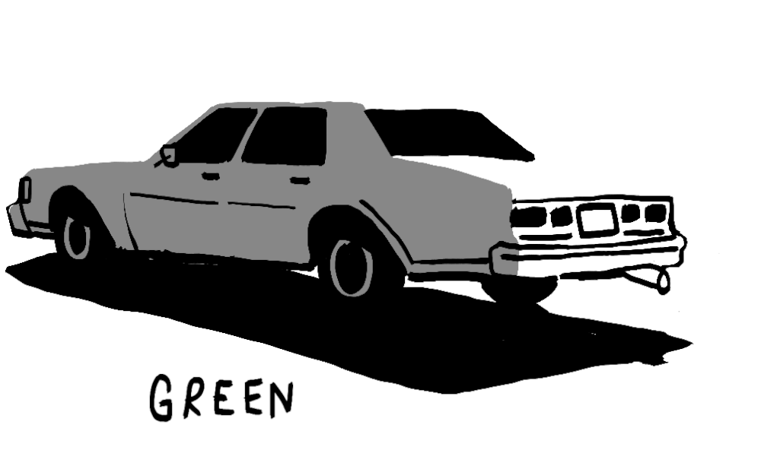
Table of contents
Introduction
Problem Definition
Description of the Data
Actionable Insights from EDA
Data Preparation for Machine Learning
Linear Regression Model
Decision Tree Models
Random Forest Models
Model Selection
Conclusion

Slide 3

Introduction
Nowadays, one of the biggest challenges to face is the reduction of greenhouse gas (GHG) from the road transport industry as it contributes 80% of the global fossil fuel energy demand, due to its reliance on fossil fuels.
Vehicle manufacturers use standard, controlled laboratory testing and analytical procedures to generate the CO2 Emissions data that appear on the EnterGuide label for vehicles in Canada.
Here we have the dataset of new light duty vehicles in Canada from Natural Resources Canada , where we have a number of different Car models and their corresponding CO2 emissions when drove over Highway as well as on City roads.
Manufacturers use the 2-cycle testing procedure, by testing vehicles under simulated city and highway conditions to find out how much fuel they use and what will be the CO2 emissions.
We will be using this dataset to develop our Machine Learning Model

Slide 4

Problem Definition
Using CO2 emissions dataset let us find out the following;
Understand how each and every column is distributed.
What are the variables that directly influence the CO2 emissions?
Develop a linear regression equation which gives the relationship between the CO2 emissions and the variables that influence it? Determine the reliability of this model.
Develop more models under Decision Tree & Random Forest. Determine their reliability based on RMSE, R-square and Adjusted R-square.
Evaluate all the models and find out the best suited ML model

Slide 5
Description of the data
Column Name | Description
MODEL YEAR | The year during which the car model was manufactured
MAKE | Name of the Car Manufacturer. Eg., DODGE, BMW, AUDI, etc
MODEL | Name of the Car Model e.g., 4WD means 4 Wheel Drive
VEHICLE CLASS | The type of Car; SUV, Compact, Two seater etc.
ENGINESIZE | The Capacity of the engine. It is measured as total volume of the cylinders in the engine. It is measured in cc
CYLINDERS | It generally denotes how many cylinders a vehicle has
TRANSMISSION | It represents the type of gear system in Car. A stands for Automatic (A4, A5 etc) and M stands for Manual (M5, M7 etc)
FUEL TYPE | It represents the type of fule used in the car. The common types of fuel are X = Regular gasoline; Z = Premium gasoline; D = Diesel; E = E85;
FUELCONSUMPTION_CITY | It is the Fuel consumed during City test. Its unit is Liters/100Km
FUELCONSUMPTION_HWY | It is the Fuel consumed during Highway test. Its unit is Liters/100Km
FUELCONSUMPTION_COMB | This reflects 55% of fuel consumption during City test + 45% of fuel consumption during Highway test
FUELCONSUMPTION_COMB_MPG | It is the combined Fuel consumption in terms of Miles per Gallon. mpg=282.48/FUELCONSUMPTION_COMB
CO2EMISSIONS | It is the Carbon-di-oxide emissions measured from tailpipe. Its unit is g/Km. This is our target variable
Columns dropped for ML
Target Variable
As shown above there are 10 columns, 6 numerical and 4 categorical.
Initially the dataset contained 1067 rows of data. But after deleting the duplicate entries, we ended up with 952 rows of data.

Slide 6
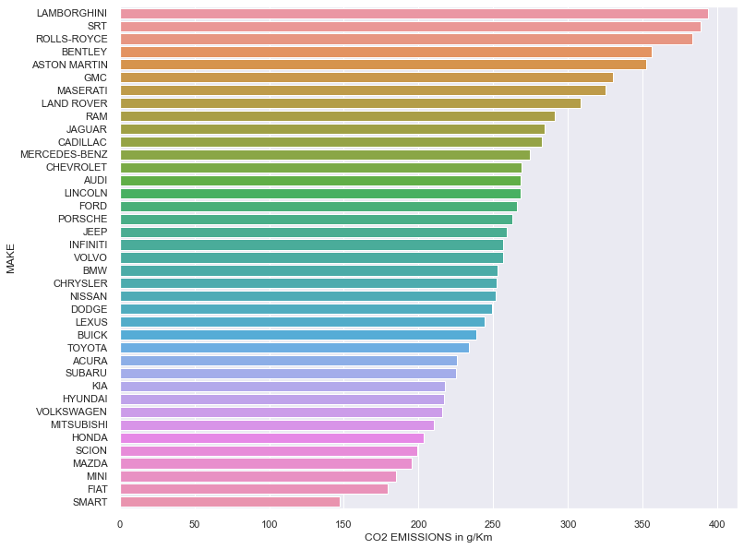
Actionable insights from EDA –Categorical Column

Slide 7
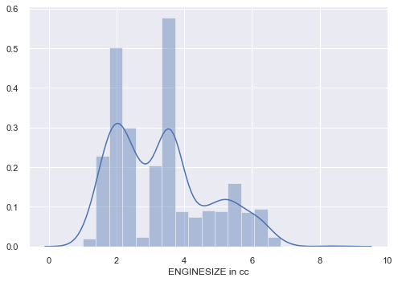
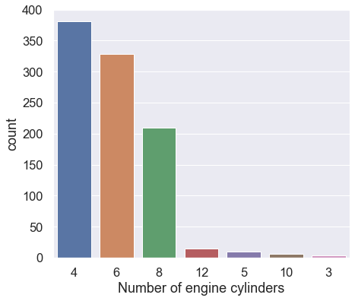
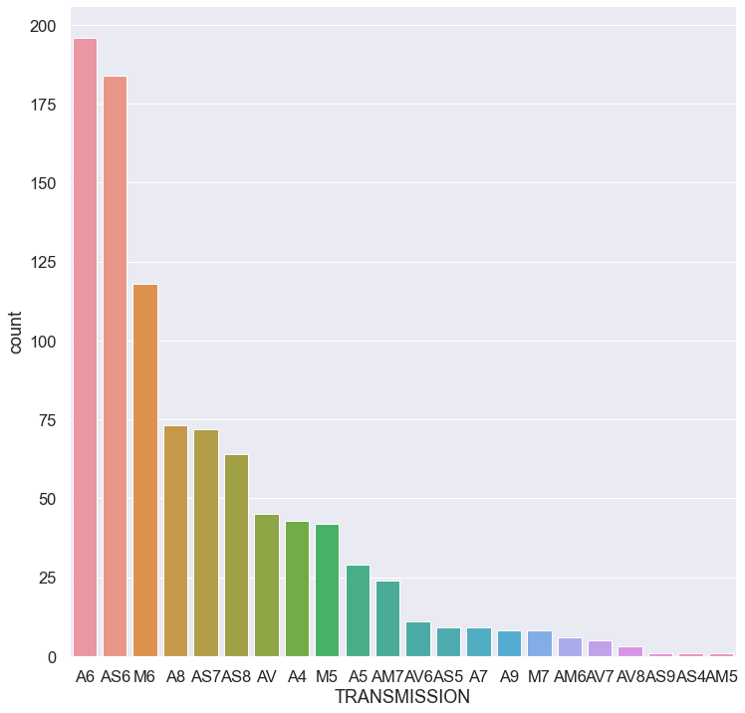
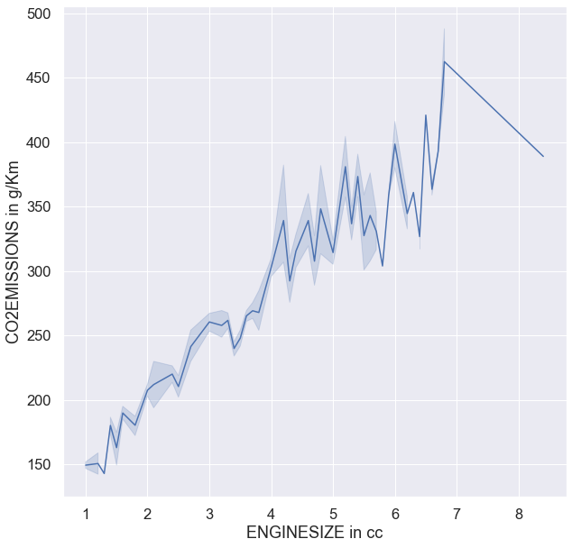
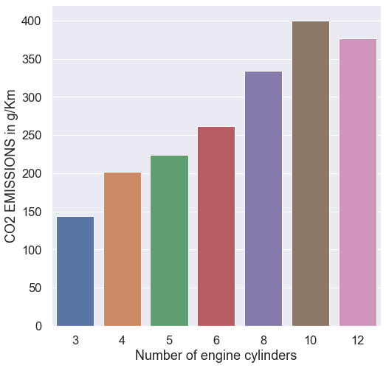
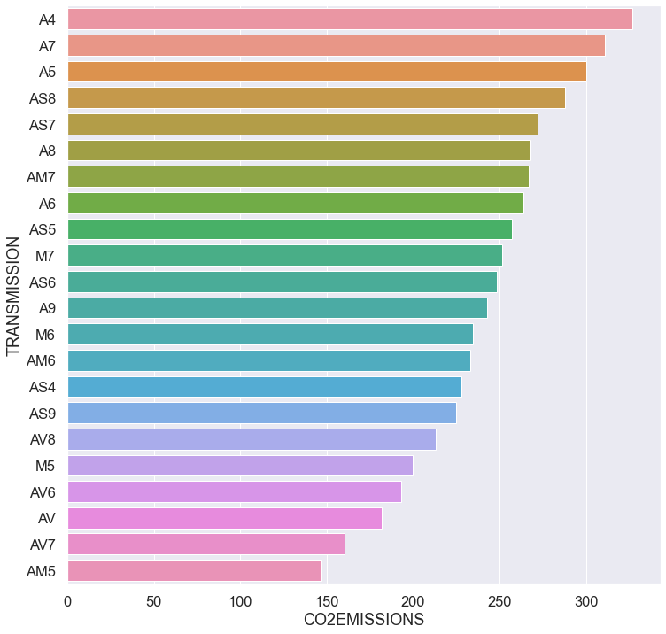
Actionable insights from EDA – Numerical columns

Slide 8
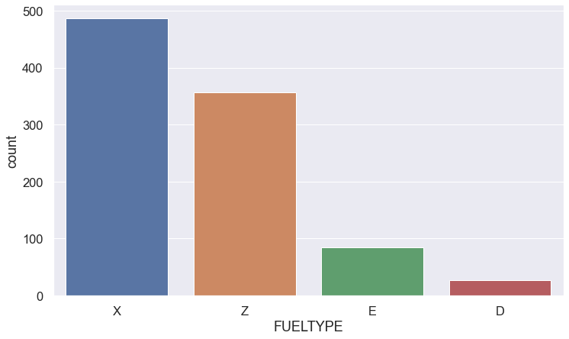
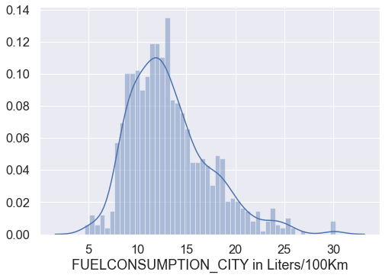
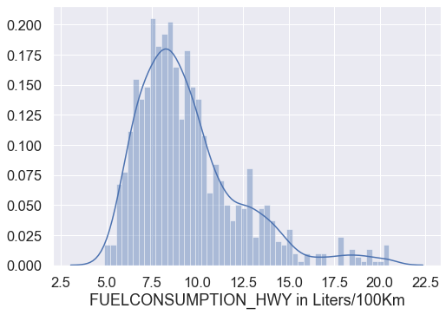
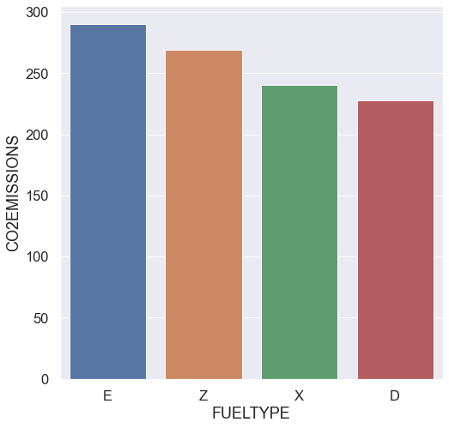
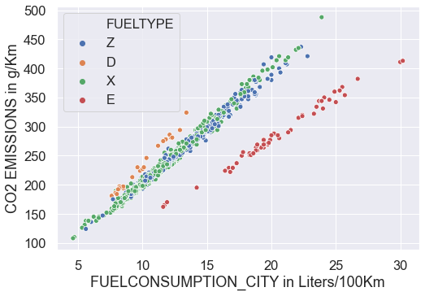
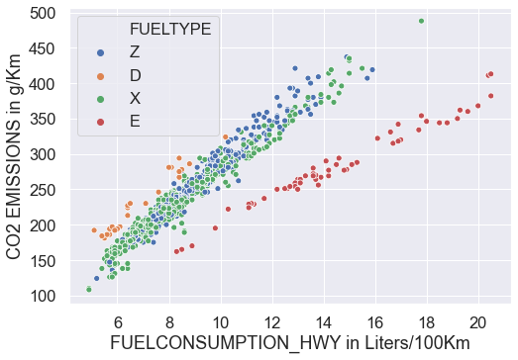
Actionable insights from EDA- Numerical columns

Slide 9
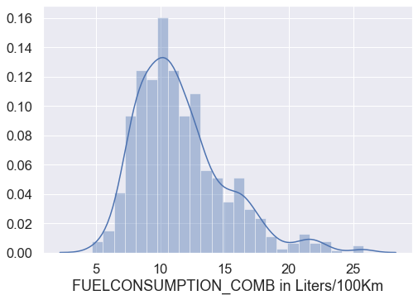
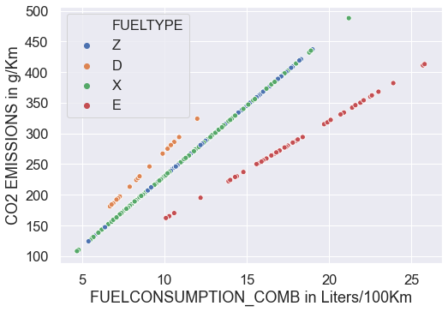
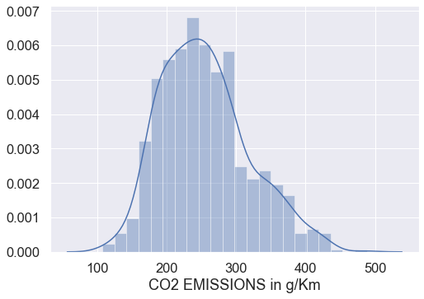
Actionable insights from EDA – Numerical Column
Target Variable column

Slide 10
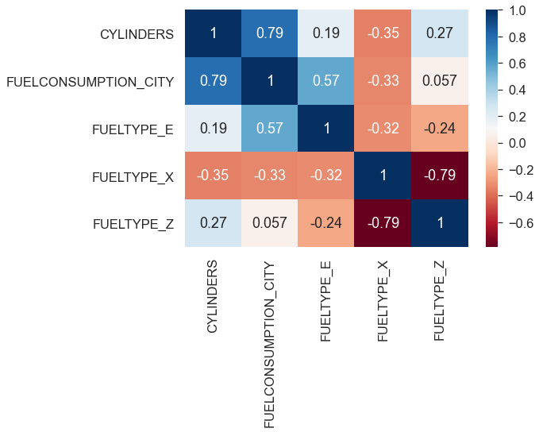
Data Preparation for Machine Learning
Assumptions of Linear Regression
Target Variable must be uniformly distributed
Linear relationship b/w independent and target variable
Explanatory variables must not be co-related with each other (|r|<0.8)
Homoscedasticity
Heat Map after data is prepared for ML
Once all the assumptions are satisfied, we separated the target variable from the dataset and spitted the data into train & test data.
We develop the model using Train data and test the model using test data.
We use a powerful python library called scikit learn to develop these models.

Slide 11
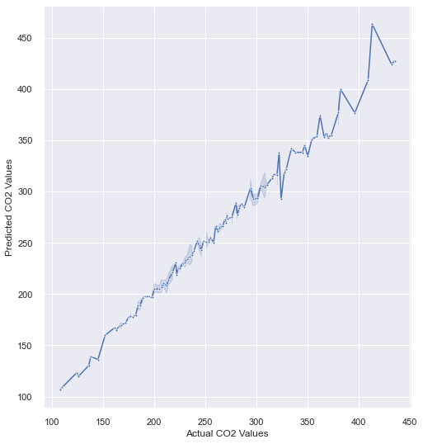
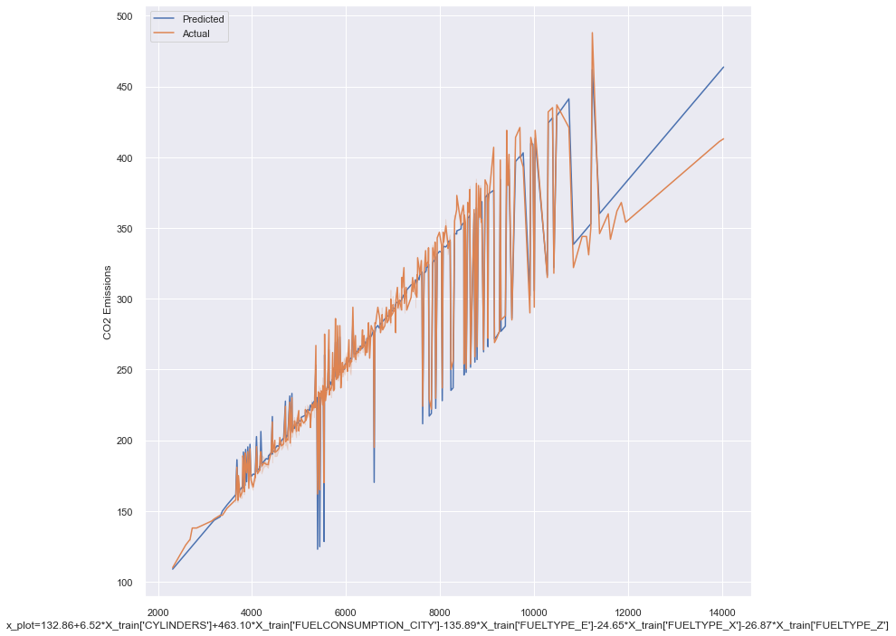
Linear Regression Model
The linear regression equation is given by Y=βₒ+ β₁X₁+ β₂X₂ + β₃X₃ +.........+ βmXm ==> Y= βX
CO2 Emissions= 132.86+6.52*CYLINDERS+463.10*FUELCONSUMPTION_CITY-135.89*FUELTYPE_E-24.65FUELTYPE_X-26.87*FUELTYPE_Z
RMSE Score Test | R-squared Value Test | Adjusted R-squared Value test
8.8226 | 0.9832 | 0.9827

Slide 12
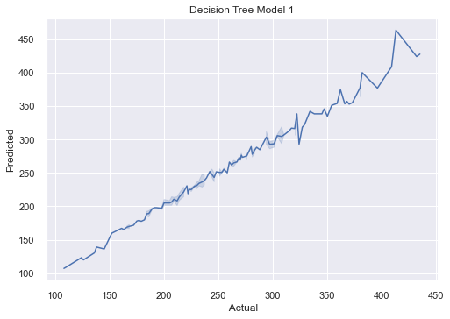
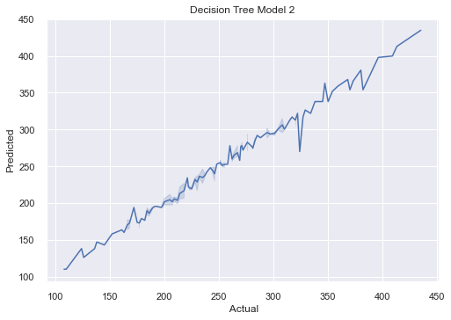

Decision Tree Models
Model Name | RMSE Score Test | R-squared Value Test | Adjusted R-square Test
Decision Tree Model-1 | 8.4647 | 0.9822 | 0.9819
Decision Tree Model-2 | 8.4231 | 0.9824 | 0.9819
GridSearchCV Model | 7.6863 | 0.9853 | 0.9849
GridSearchCV Model

Slide 13
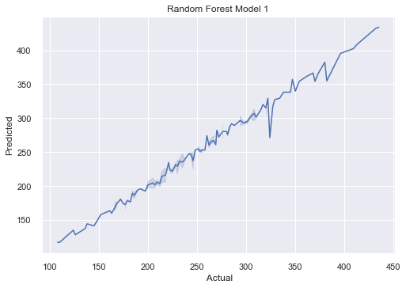

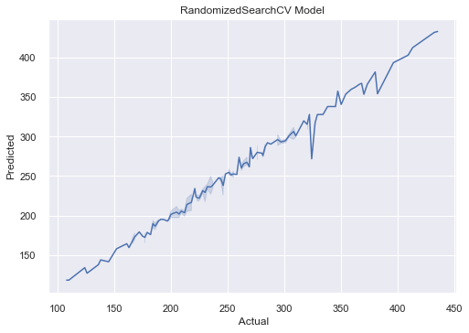
Random Forest Models
Model Name | RMSE Score test | R-squared value test | Adjusted R-squared test
Random Forest Model-1 | 4.2409 | 0.9841 | 0.9837
Random Forest Model-2 | 8.0166 | 0.9840 | 0.9836
RandomizedSearchCV Model | 8.7588 | 0.9789 | 0.9800

Slide 14
Conclusion
To sum up, we have developed a total of 7 models under Linear Regression, Decision Tree and Random Forest. We trained these models with our train dataset and tested each models with our test dataset. Each model gave us excellent results with an accuracy of >97%.
Even though we can say that all the models have performed exceptionally well, we have to choose the best model which has given better R-squared and also Adjusted R square results.
Out of the 7 models under 3 categories of Linear Regression, Decision Tree and Random Forest, the best models from each section are as under;
4. From the above table, we can say that GridSearchCV is the best suited model to predict the CO2 emissions with least errors.
Model Name | RMSE Score test | R-squared value test | Adjusted R-squared test
Linear Regression | 8.8226 | 0.9832 | 0.9827
GridSearchCV Model | 7.6863 | 0.9853 | 0.9849
Random Forest Model-1 | 4.2409 | 0.9841 | 0.9837

Slide 15
Thank you

